Slide 1

UNIX System 운영기법
강유은, 유호경, 윤기성, 차성훈

Slide 2

Contents
The Roll of Team & Time Table
Architecture
AIX Installation
Logical Volume
Logical Volume Manager
File System
UNIX Server Application
Realization

Slide 3




00-1
The roll of the team
강유은
유호경
Exercise 9
Step-by-step 캡처
DLPAR, File System
개념 설명
Exercise 7
Step-by-step 캡처
LPAR, HMC 개념 설명
PPT 제작
윤기성
차성훈
Exercise 8
Step-by-step 캡처
가상화 개념 설명
조장
이중화 개념 설명
Time Table 작성
AIX 설치 개념 설명
및 Step-by-step 캡처

Slide 4
00-2
Time Table
 | 7/10 | 7/13 | 7/14 | 7/15 | 7/16 | 7/17
10:00 | PPT 계획 및 역할분담 | PPT 초기 구성 | PPT 1차 수정 | PPT 2차 수정 | PPT 3차 수정 | 피드백 및 PPT 4차 수정
11:00 |  |  | 이중화, 가상화 부분 추가 |  | AIX 설치 부분 추가
12:00 | PPT 자료 수집
13:00 |  |  |  | Exercise 부분 추가 및 PPT 3차 정리
14:00 |  | PPT 1차 정리 |  |  |  | 대본 작성 및 PPT 최종 정리
15:00 |  |  | PPT 2차 정리
16:00 |  |  |  |  | PPT 4차 정리

Slide 5
01
Architecture
Part#0
Virtual
I/O Server
Part#1
Linux
Part#2
AIX V7
Part#3
I5 /OS
Part#4
AIX V5
Part#5
AIX V6
Part#6~8
AIX V7
Linux
Client16
Client17
Client18
Clinet19
Client20
Network
Disk
HMC
os
os
os
AIX V7
KERNER
Linux
KERNER
AIX V7
KERNER
I5 /OS
KERNER
AIX V5
KERNER
AIX V6
KERNER
Virtual Ethernet
Storage
Replication
Part#0
Virtual
I/O Server
Part#1
Linux
Part#2
AIX V7
Part#3
I5 /OS
Part#4
AIX V5
Part#5
AIX V6
Part#6~8
AIX V7
Linux
Client16
Client17
Client18
Clinet19
Client20
Network
Disk
os
os
os
AIX V7
KERNER
Linux
KERNER
AIX V7
KERNER
I5 /OS
KERNER
AIX V5
KERNER
AIX V6
KERNER
Virtual Ethernet

Slide 6
01-2
Replication
Primary
Server
Backup
Server
Replication
Technology that can copy and manage about physically seperated some of database to remote database.

Slide 7


01-2
Replication
Workload Fallover
WAN
Production
Node
Standby
Node
Client

Slide 8
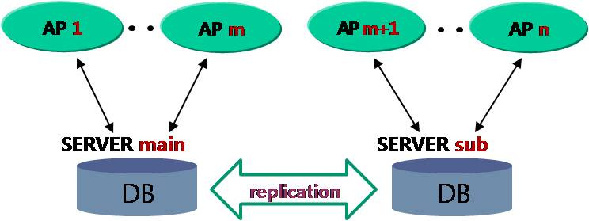
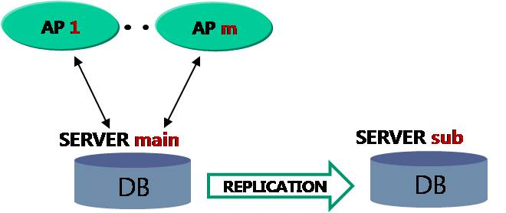
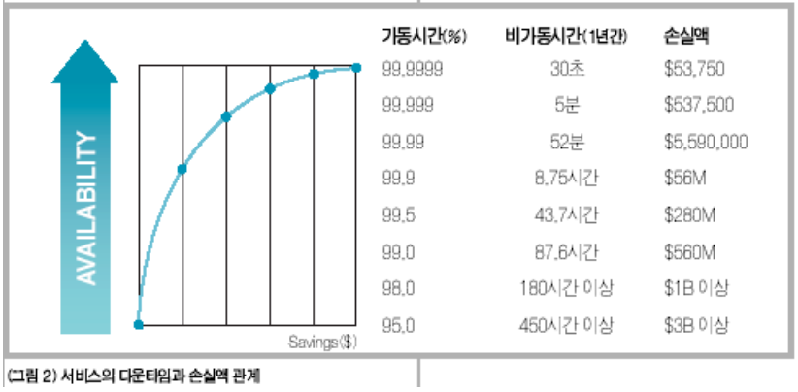
01-2
Replication
- Purpose
It can improve server's performance by scattering
data usage to other server.
It can minimize damage when disruption occur in server system
It make sure of high availability
Notes:
고가용성 확보
일반적으로 가용성이란 시스템의 정지 없이 서비스가 가동될 수 있는 확률을 의미.
고가용성이란 긴 시간 동안 지속적으로 서비스를 운영이 가능한 시스템, 컴포넌트를 의미.
부하분산을 통한 성능 개선.
이중화로 구성된 DB는 항상 같은 데이터를 가지고 있기 때문에 하나의 DB를 사용해서 모든 어플리케이션을 처리할 때보다 업무 특성을 고려, 어플리케이션을 분산, DB에 가해지는 부하가 감소, 이는 전체적인 성능 향상을 가져옴.
장애, 재해 시 데이터손실 최소화
물리적인 시스템 장애나 천재지변과 같은 재해 시에 하나의 시스템을 운영하게 되면 장애를 복구할 동안 정상적인 서비스를 할 수 없게 됩니다. 그래서 일반적으로 백업 서버를 운영하게 되는데, 이중화를 사용하게 되면 백업 서버의 운영을 손쉽게 할 수 있습니다

Slide 9
01-2
Replication
- Features
High Availability
Database Consistency
High Performance
Load Balancing
& Scalability
Notes:
High Availability
-서비스 중이던 시스템 또는 소프트웨어가 고장이 나면 사용 가능한 시스템으로 즉시 접근이 가능하여야 함.
Database Consistency
-하나의 데이터베이스 서버 내에서 이중화 트랜잭션과 로컬트랜잭션이 동시에 같은 데이터를 접근하는 경우가 발생 -이러한 데이터의 충동 발생시 데이터 충돌이 해결 되어야 함.
High Performance
-이중화 하는데 수반되는 오버헤드를 최소화
-독립시스템으로 트랜잭션을 처리할 때의 성능을 유지하도록 해야 함.
Load Balancing & Scalability
-다중서버 운영환경에서 서비스하는 트랜잭션들을 두 그룹이상으로 나누어, 각각의 트랜잭션이 해당서버에서 수행 되도록 하여야 함.
-각 서버에서 변경되는 데이터베이스 내용을 다른 서버들에 반영시킴으로써 서버에 걸리는 부하를 분산시킬 수 있도록 하여야 함.

Slide 10
01-3
Virtualization
Part#1
AIX V7
Part#2
Linux
Part#3
I5/OS
Part#4
AIX V5
Part#5
AIX V6
Part#6-10
AIX V7/
Linux
If physical disk consist of only LPAR, We connect network card to all LPAR.
This way spend much money, and impossible to connect everything.
os
os
os
os
AIX V7
Kernel
Linux
Kernel
I5/OS
Kernel
AIX V5
Kernel
AIX V6
Kernel
Network Card

Slide 11
01-3
Virtualization
Part#0
Virtual
I/O Server
Part#1
AIX V7
Part#2
Linux
Part#3
I5/OS
Part#4
AIX V5
Part#5
AIX V6
Part#6-10
AIX V7/
Linux
os
os
os
AIX V7
Kernel
AIX V7
Kernel
Linux
Kernel
I5/OS
Kernel
AIX V5
Kernel
AIX V6
Kernel
But if we had extra LPAR that can manage all of disk and network,
How nice it would be for user ?
Virtual Ethernet

Slide 12
01-3
Virtualization
Each of Client
Partition
Virtual I/O Server
Partition
Hypervisor
Virtual
Ethernet
Virtual
Switch
Virtual
Ethernet
Layer 2
Bridge
Physical
Ethernet
One of LPARs called Virtual I/O Server that manage virtualization have physical disc and network card.
This way can divide disk logically to use for LPAR, and don't need to equip network card as much as number of LPAR.
Virtual
Ethernet
Virtual Disk
Logical Disk
Client
Adapter
Server Adapter
Device
Mapping
SCSI RDMA Protocol
DMA
Buffer
Device DMA Transfer

Slide 13
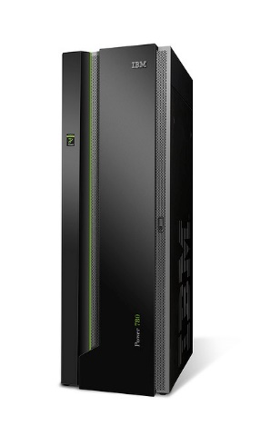
01-4
LPAR (Logical PARtition)
Service
Processors
Exists when the isolation is implemented with firmware
Independence
LPAR 1
Reliability
LPAR
Stability
Ability to make a single system run
AIX 5.3
LPAR 2
Linux
Own Environment
- Operating system
- Resources : Process, memory, devices
LPAR 3
LPAR
AIX 6.1
LPAR 4
Windows
LPAR
Model : POWER 770

Slide 14
01-5
DLPAR (Dynamic Logical PARtitioning)
HMC
HMC Command
Partition A
Partition B
Dynamically Move
Hypervisor

Slide 15
01-5
DLPAR (Dynamic Logical PARtitioning)
5 core
- 2 core active
- 3 core not active
2 core
- 2 core active
Dynamically Move(add, remove) resources without reactivation(shut down) of a partition
→Adapter
Memory
Core
Processor
I/O allocation
Notes:
같은 박스 내 각기 다른 LPAR에서 자원의 이동.
운용중인 서버에 영향 X

Slide 16
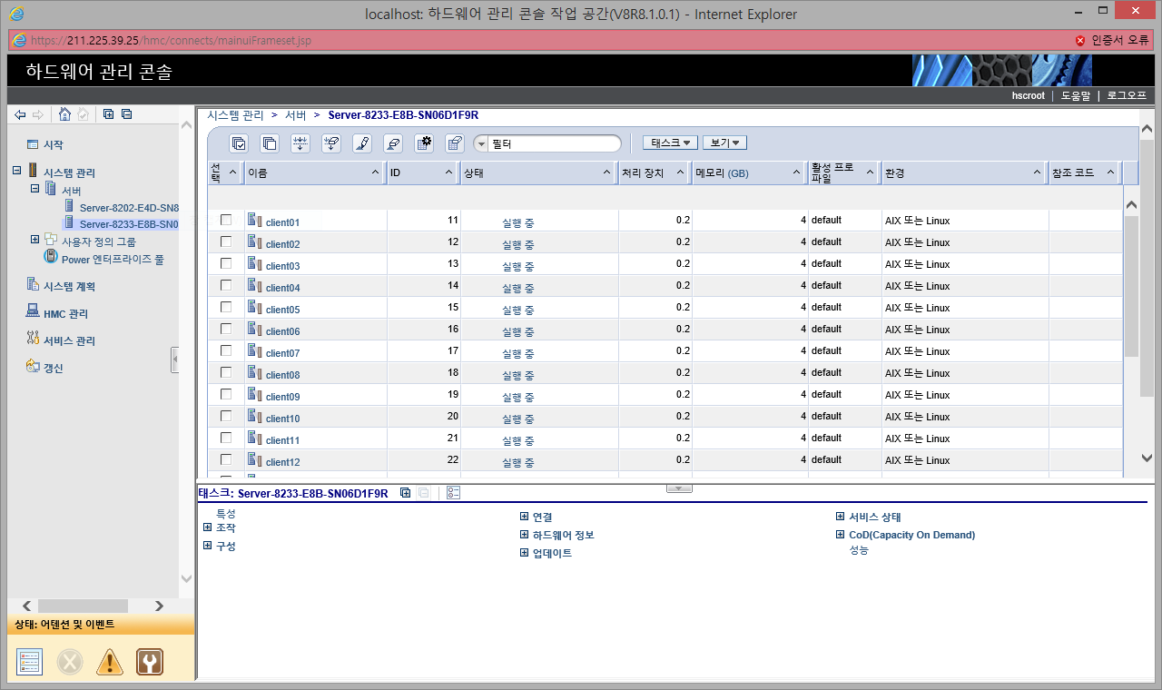
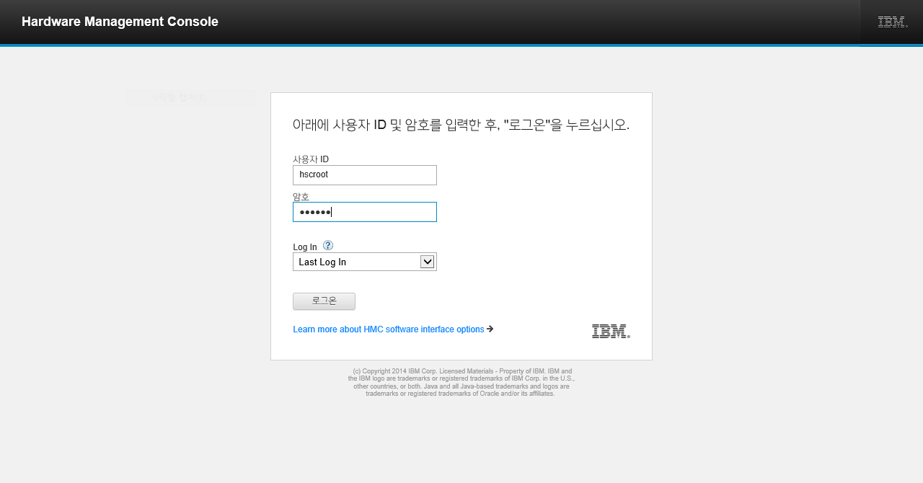
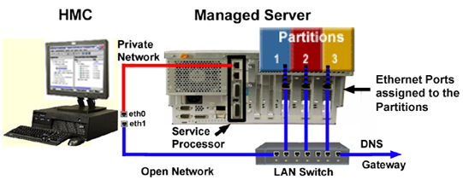
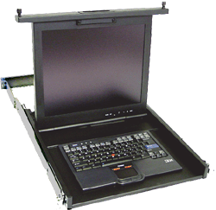
01-6
HMC (Hardware Management Console)
LPARs
Running AIX
Managed
Systems
- Desktop
Rack-mount
Navigation
area
Proc &
MEM resources
Virtual console windows
LPAR configuration and operation management
Capacity on Demand (CoD) management
Service tools
Access to Live Partition Mobility function
Task
Pad
Access to HMC
Notes:
사용자 프로파일 및 액세스 관리, 사용자 및 태스크 관리, 원격 명령 실행, 인증서 관리, 설치 자원 관리

Slide 17
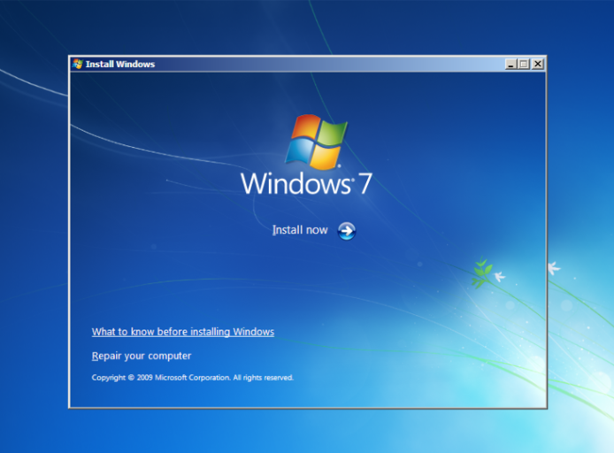
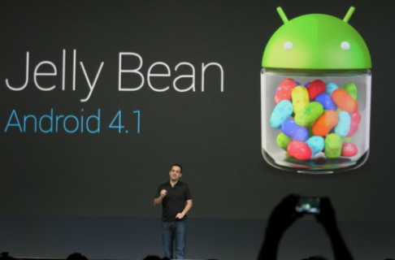
02
AIX installation
Preserves SOME of the existing data on the disk selected for installation.
This method overwrites the /usr, /var, /tmp, /(root)file systems.
Ex)
Upgrade smart phone software
(lollipop -> jelly bean)
New and Complete Overwrite
Overwrites EVERYTHING on the disk selected for installation.
Ex)
Windows OS install
Initialization of device
New and Complete Overwrite
Preservation Install
Preservation Install
Migration Install
Migration Install
Upgrades the Base Operating System to the current release.

Slide 18
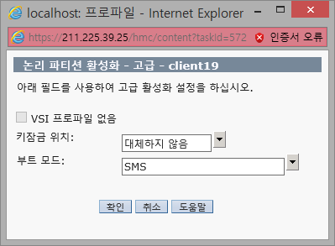
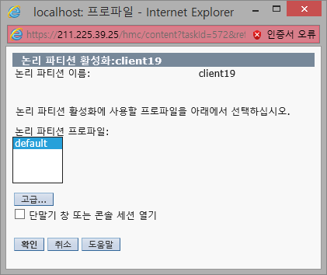
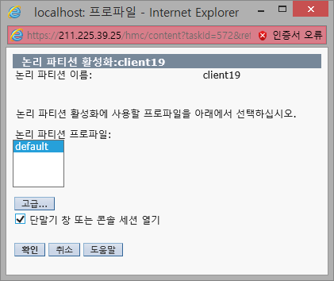
02-1
AIX installation
Changing profiles
- Checking the box
Changing profiles
Set SMS mode

Slide 19
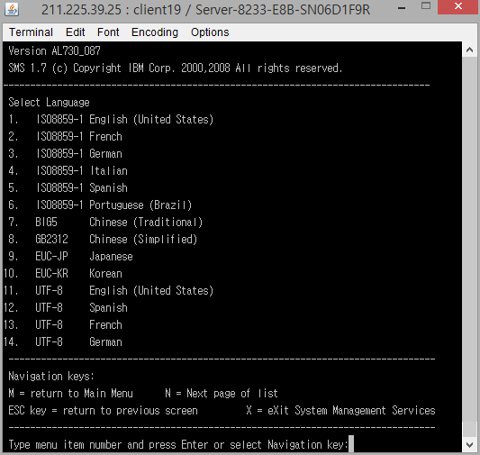
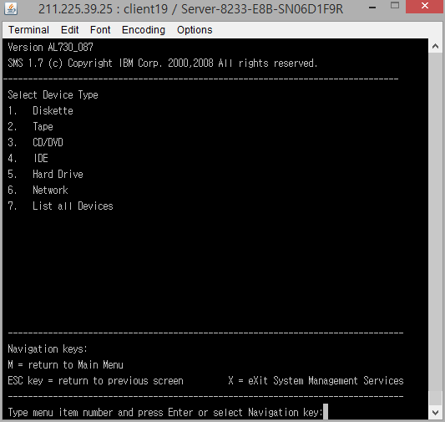
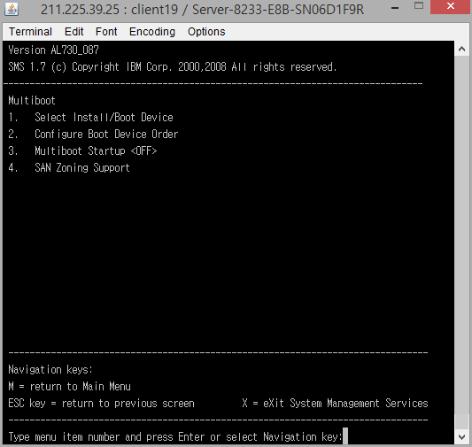
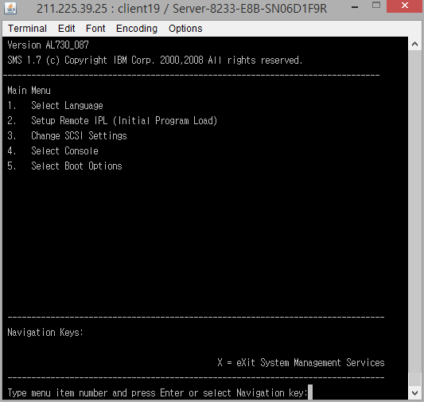
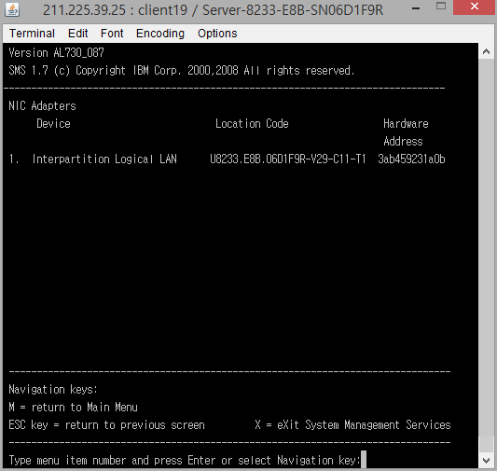
02-2
AIX installation
- SMS Mode
Device type to boot
Initial Screen of SMS mode
Boot option
Installation language selection
Setup installation IPL

Slide 20
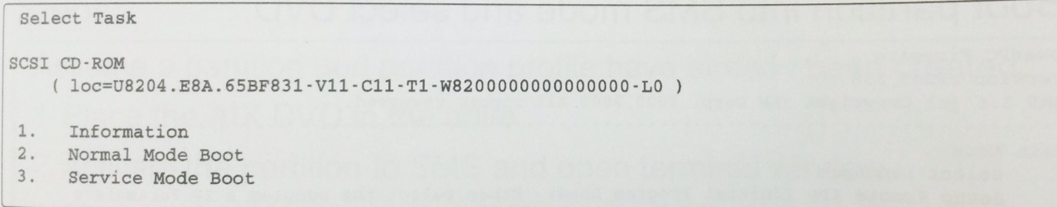
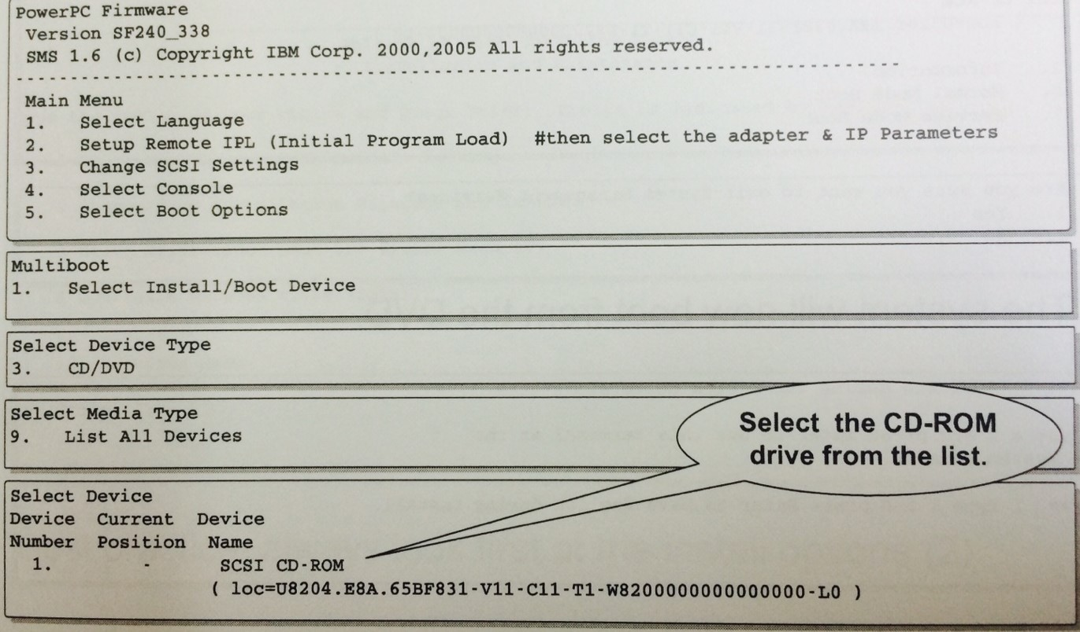
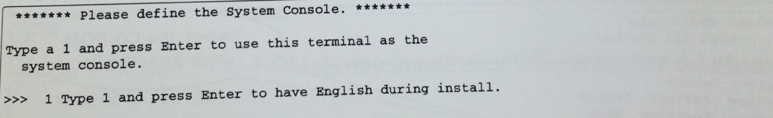
02-3
AIX installation
- DVD
The system will now boot from the DVD
Boot partition into SMS mode and select DVD

Slide 21
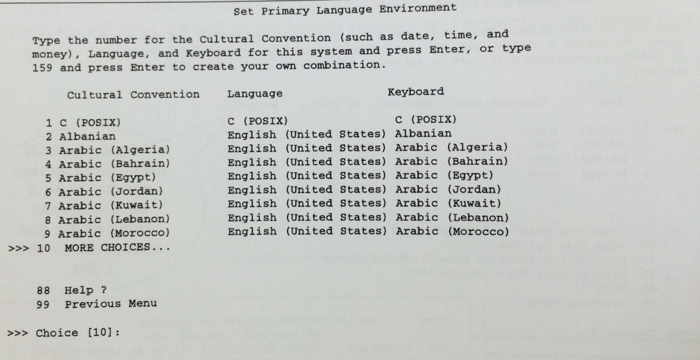
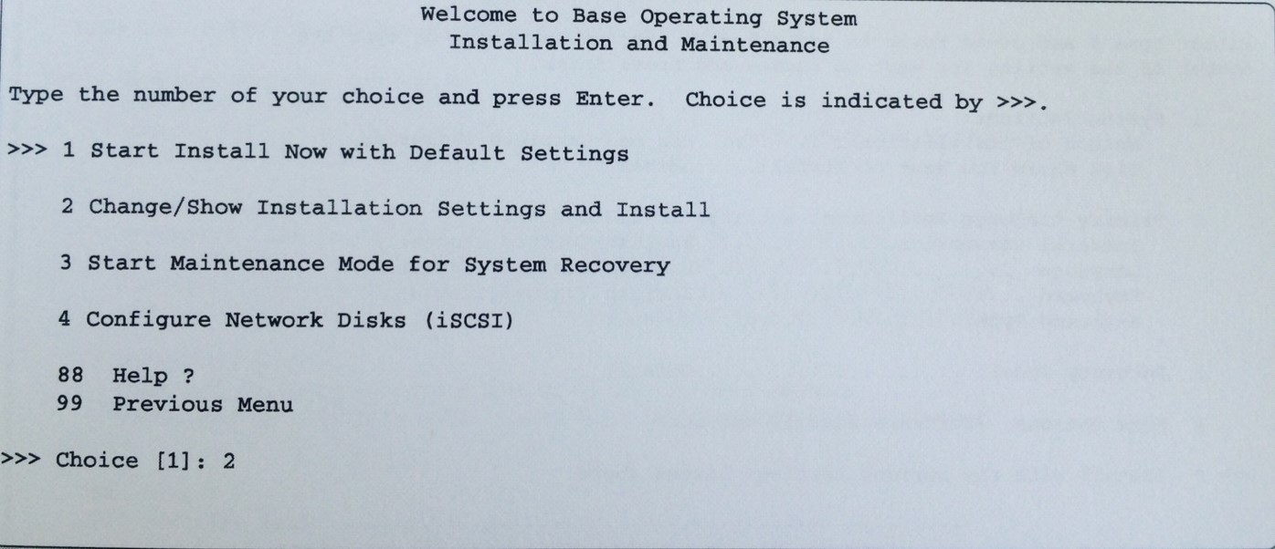
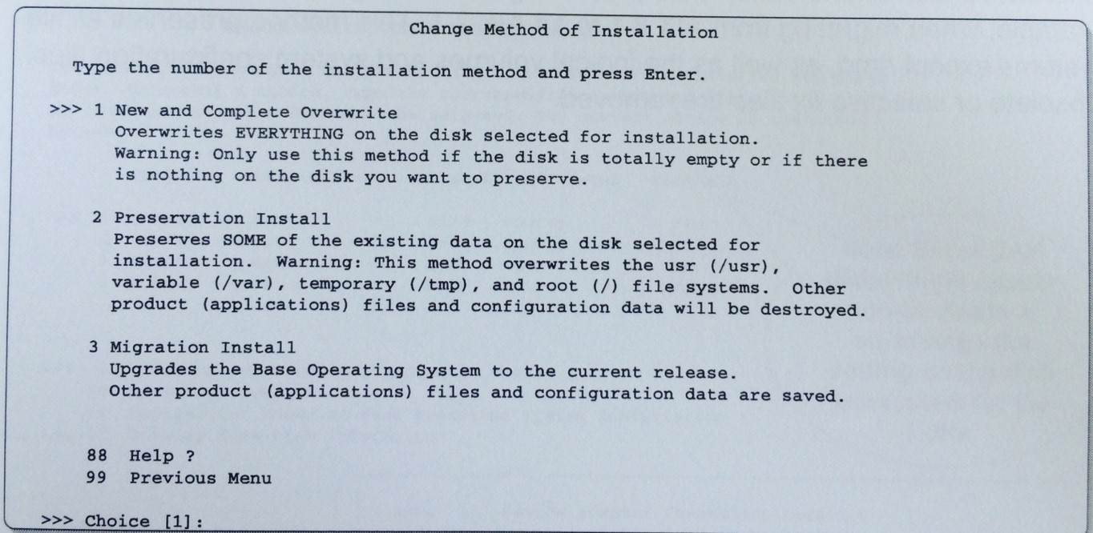
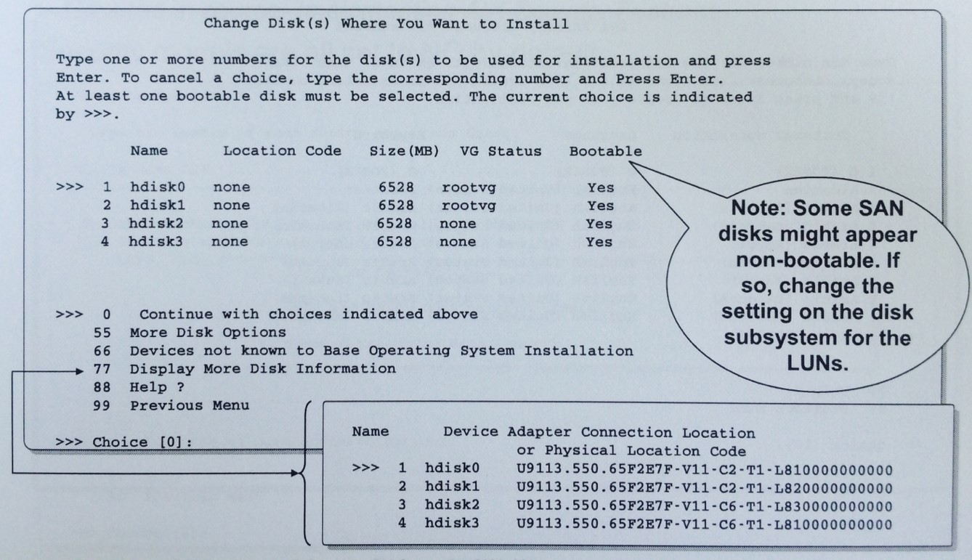
02-3
AIX installation
- DVD
Default
= en_US
Select disks to be used for the installation
Main Installation and Maintenance menu
Change Method of Installation
Set primary language environment

Slide 22
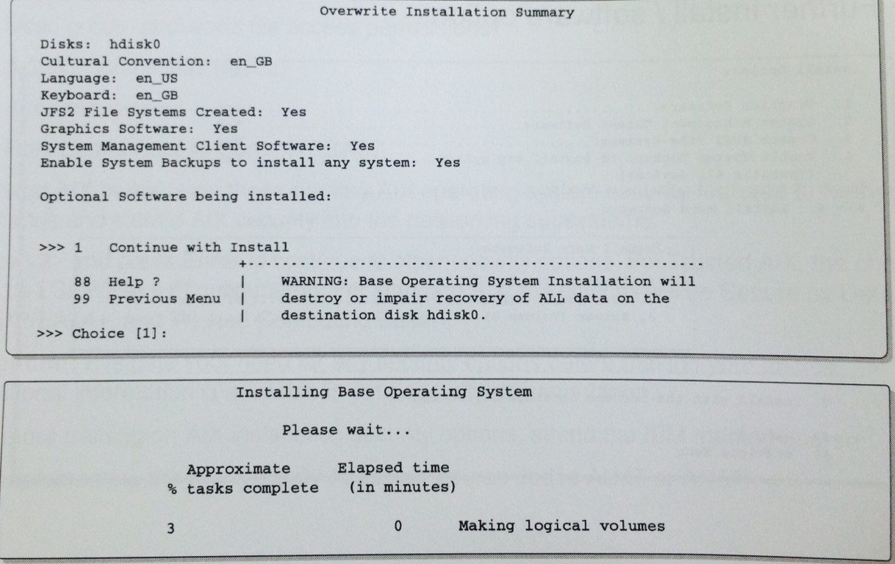
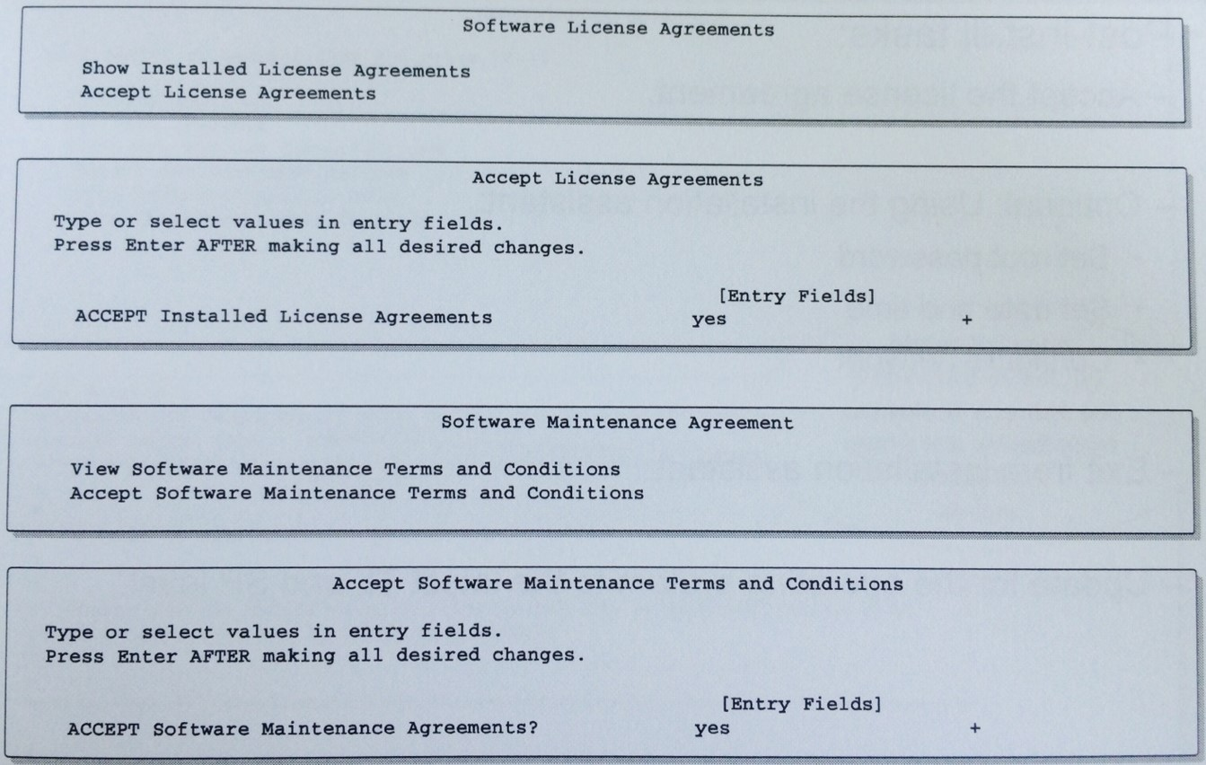
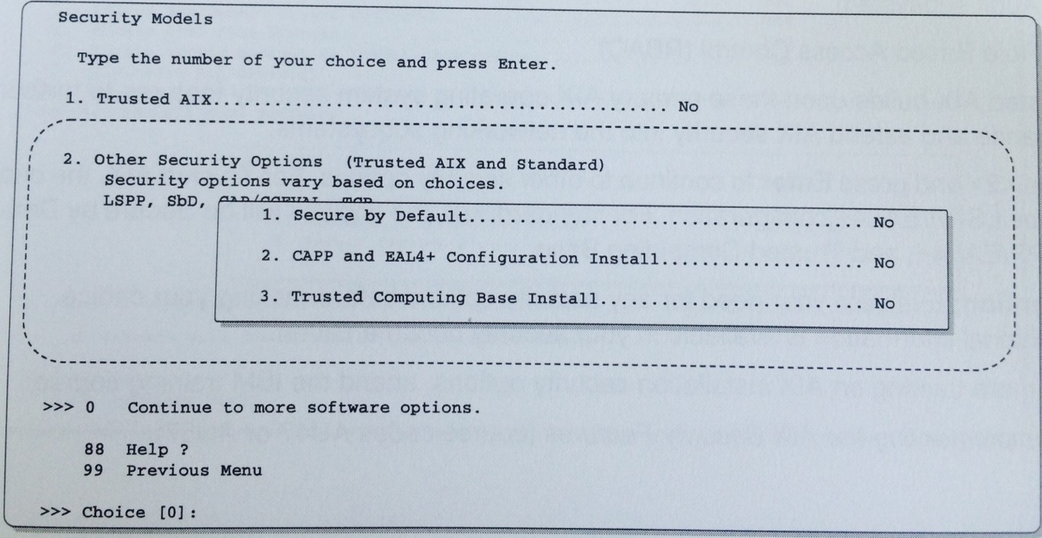
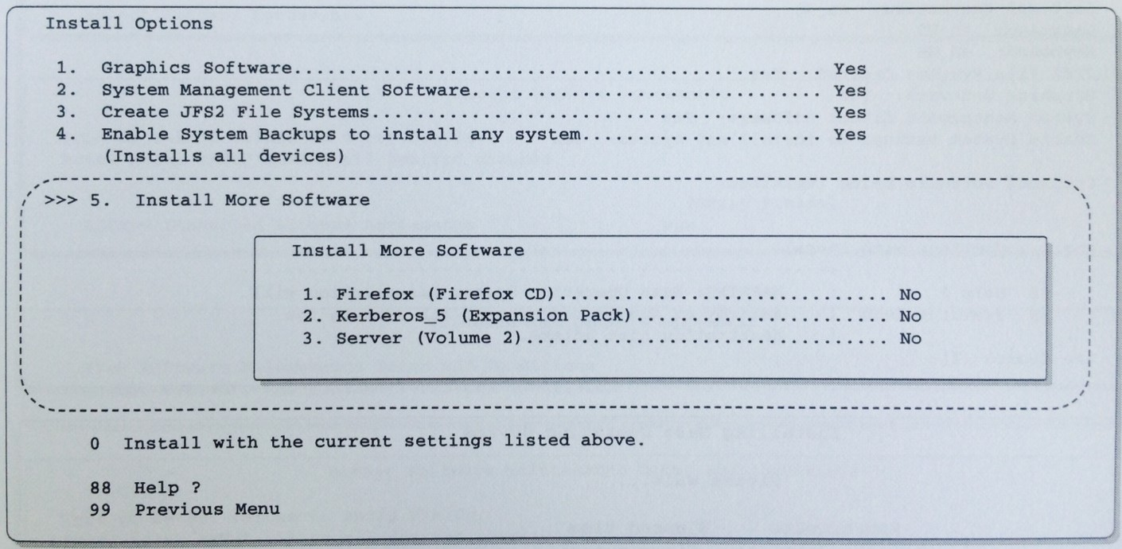
02-3
AIX installation
- DVD
X11, CDE, WebSM, Java and other software is installed.
Installing
Security models are all set to No by default.
Security Models
Accept license agreements
Install summary and installation
Software install options

Slide 23
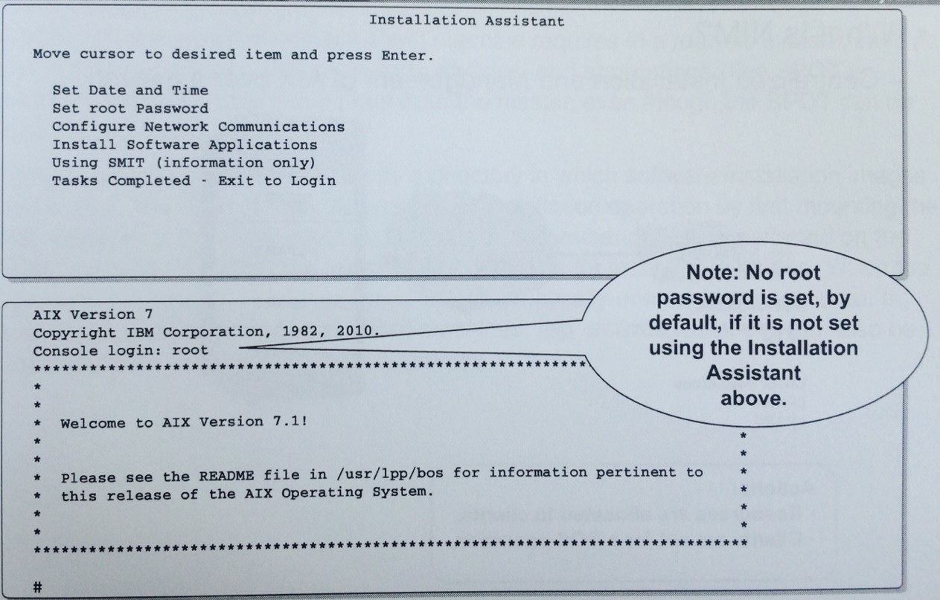
02-3
AIX installation
- DVD
Installation assistant and login

Slide 24
03-1
Logical Volume
- Logical Volume Manager Components
Volume Group
Physical
partitions (PPs)
Logical
partitions (LPs)
Largest unit of storage allocation (consist of a group of physical volumes)
Pieces of physical volumes in a volume group (All PVs within a volume group are the same size)
Each logical volume consists of one or more logical partitions
1
2
3
write(data);
Name for an actual disk or hard drive (can be internally or externally attached)
4
x
y
Groups of information located on physical volumes
Application
Logical
volumes (LVs)
Physical
volumes (PVs)

Slide 25
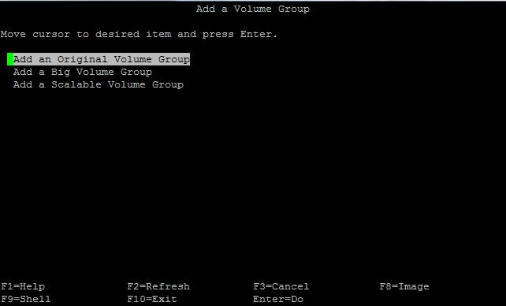
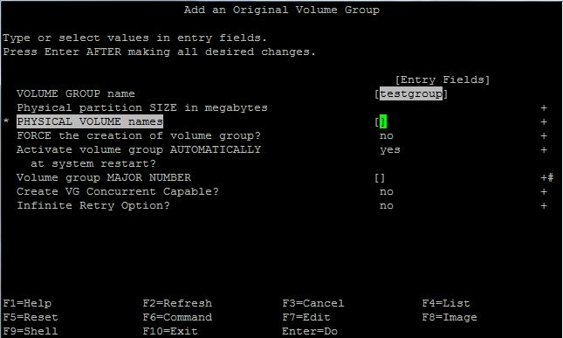
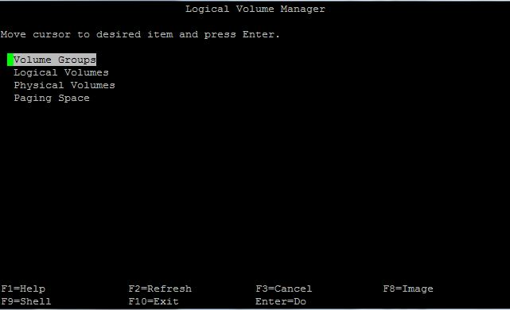
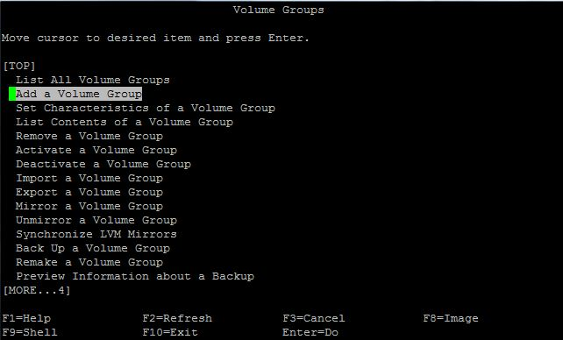
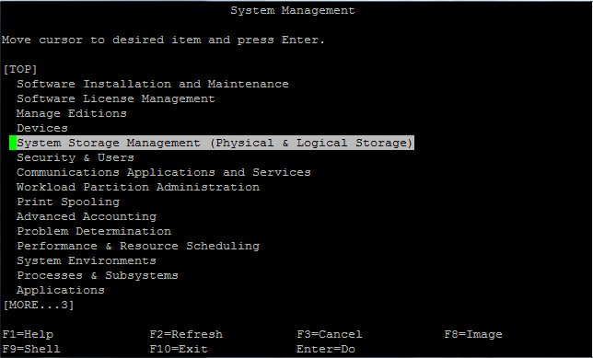
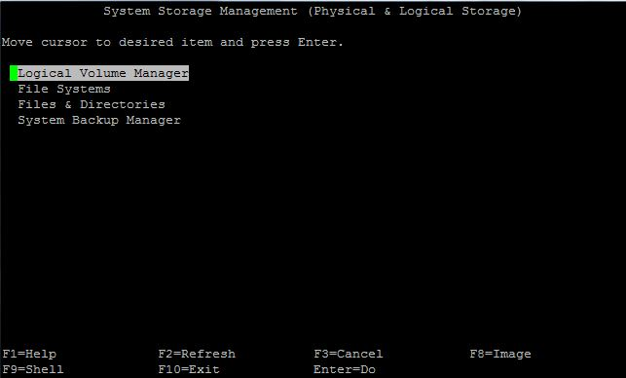
03-2
Logical Volume
- How to add Volume Group
# smit lvm
# smit
# smit mkvg

Slide 26
04
LVM (Logical Volume Manager)
Benefits of the LVM
Physical
storage
Logical
storage
File systems
Sizes can
dynamically increased
Data can be
relocated
Data can span
disks
Directories
Files
Data can be
mirrored for
availability
LVM statistics
can be collected
Managed by
Logical Volume Manager (LVM)

Slide 27
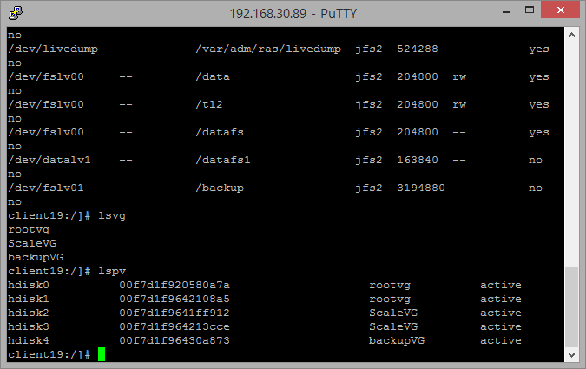
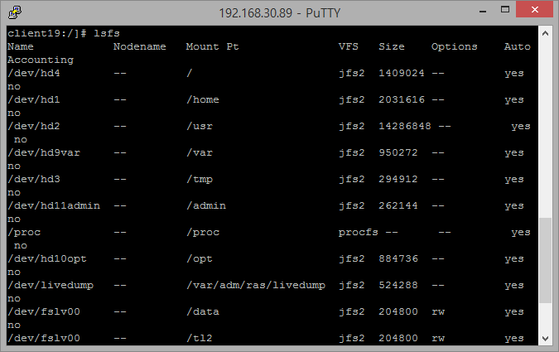
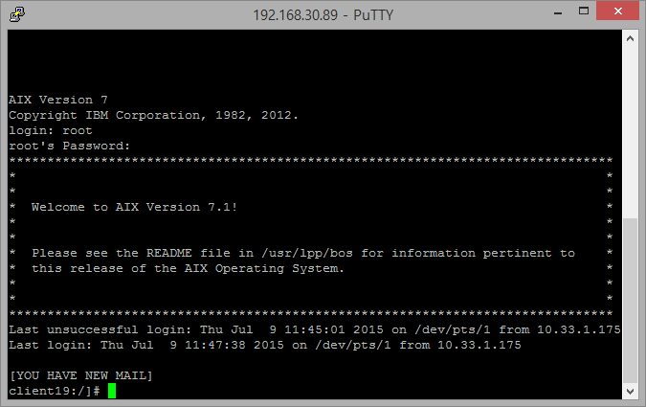
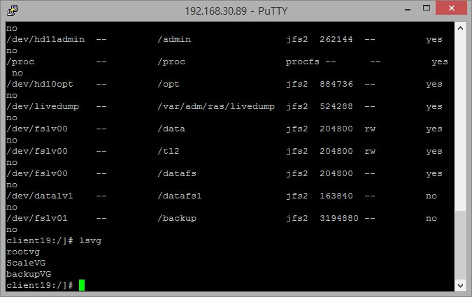
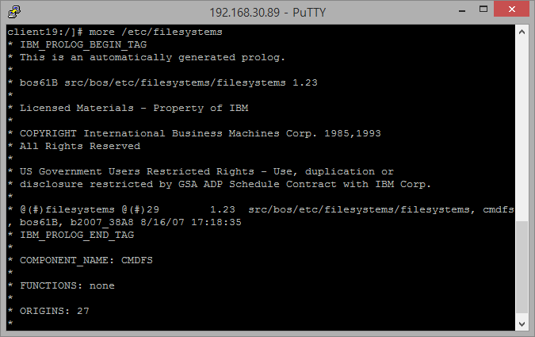
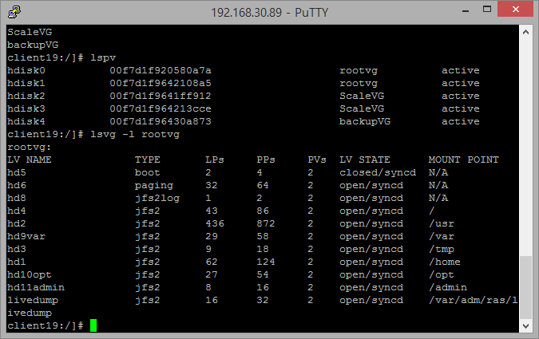
04-1
Exercise 7
- System storage overview : LVM commands
Execute the command : lspv
Execute the command : lsvg –l rootvg
Execute the command : lsfs
Log in as the root user
List the file systems on your machine
Execute the command : lsvg
The list of all defined physical volumes on the machine
A list of all the logical volumes contained in rootvg
The list of all defined file systems on the machine
The list of all volume groups defined on the machines

Slide 28
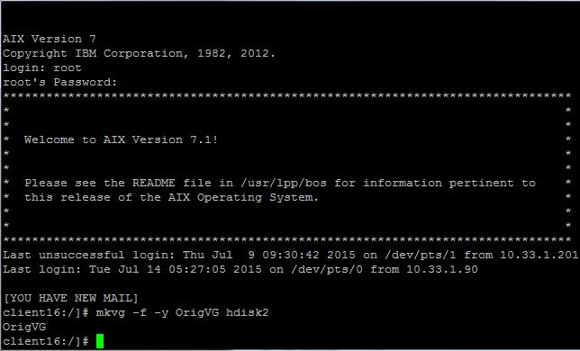
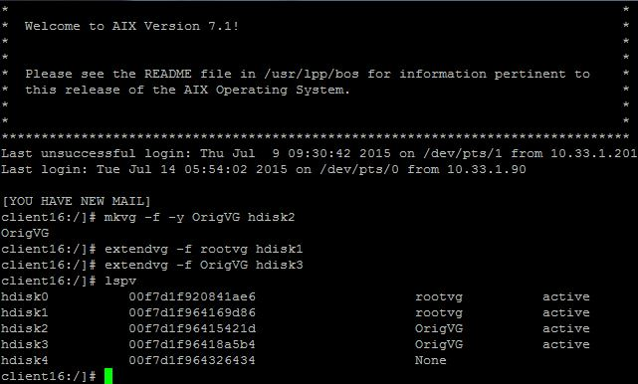
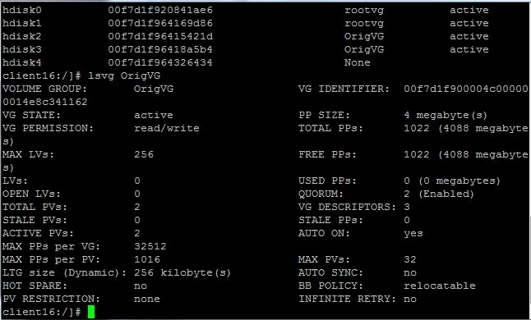
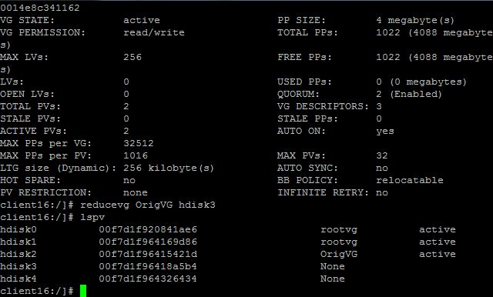
04-2
Exercise 8
- Working with LVM
List the VG attributes of OrigVG
Remove disk hdisk3 from OrigVG
Verify that the disk is no longer
associated with OrigVG
Create a new original VG
on hdisk2 called OrigVG
Add free disks – hdisk1 into rootvg
hdisk3 into OrigVG
And check

Slide 29
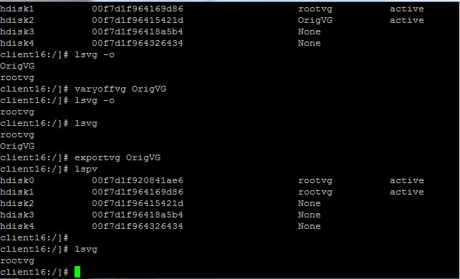
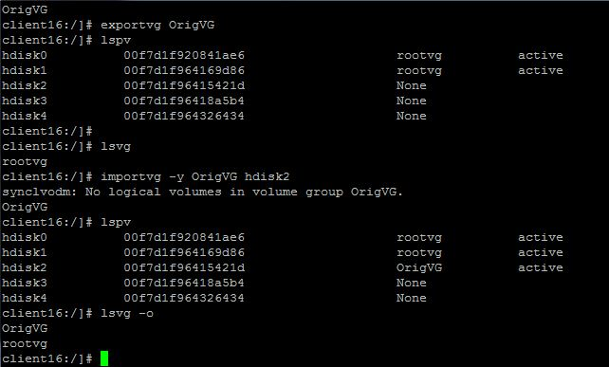
04-2
Exercise 8
- Working with LVM
The OrigVG should be in the list
The OrigVG should not be in the list
The OrigVG should be in the list
The OrigVG should not be in the list
Reimport and activate the VG

Slide 30
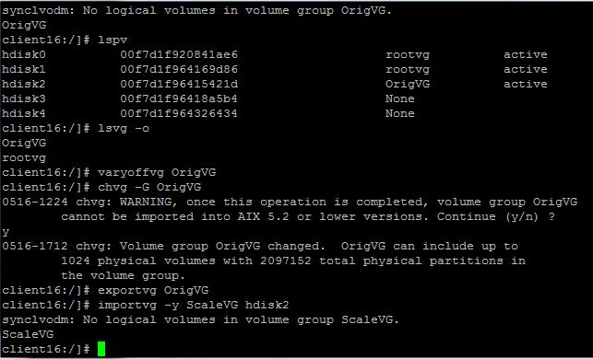
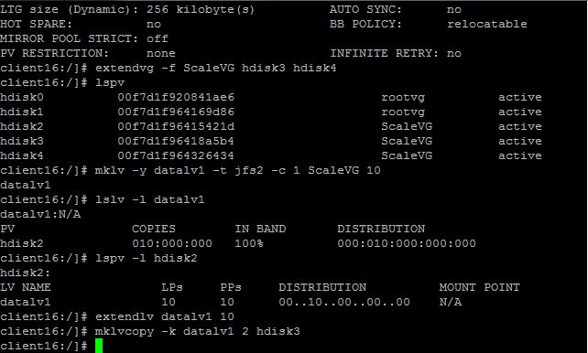


04-2
Exercise 8
- Working with LVM
Extend ScaleVG to include disks
Add a logical volume to ScaleVG
Increase the size of datalv1 by 10 LPs
Create a mirror copy
Convert and rename OrigVG
Verify a copy of the data was
successfully mirrored to hdisk3
List the ScaleVG attributes

Slide 31




04-2
Exercise 8
- Working with LVM
#lslv stripelv
- Shows the stripe size and stripe width
Check that the LPs have been striped
(shows that the LPs are distributed)
Check to see how many PPs
have been created on each disk
Create a striped logical volume named stripelv
Delete logical volume, stripelv

Slide 32




04-2
Exercise 8
- Working with LVM
Add another logical volume to ScaleVG, on hdisk4
Display the LV in the rootvg to
see that there are mirrored
Display current location of the datalv2 LPARs
Migrate the LV datalv2 to hdisk2
And check
Accepting all the default options,
mirror rootvg to hdisk1
Create a boot image on hdisk1
Update the normal bootlist to include hdisk1
Reduce the ScaleVG volume group to
not include hdisk4

Slide 33






04-2
Exercise 8
- Working with LVM
Query the physical volumes in both volume groups
List the volume group attributes of rootvg
List all the logical volumes in each volume group
List the physical volume partition map for hdisk1
List all logical volumes on hdisk1
List the logical volume attributes of datalv1

Slide 34



04-2
Exercise 8
- Working with LVM
Discover which disk datalv is mirrored
Reduce the mirroring and update the bootlist and clear the boot record
Display the detailed mapping

Slide 35

04-3
File System
Known as a system for managing files that are stored in the auxiliary memory unit
and that the operating system. In some cases, each of the files and the structure
stored in the auxiliary storage device.

Slide 36




04-4
Exercise 9
- File System administration
Create an enhanced file system
List all of the logical volumes in ScaleVG
View the stanza in the /etc/filesystems file
Mount the /datafs file systems and recheck

Slide 37




04-4
Exercise 9
- File System administration
The Auto attribute should have a value of no.
The Auto attribute is now yes.
List the filesystems characteristics
Create an enhanced JFS2
Change the file system characteristics
Check the value of the Auto attribute
Mount file system /datafs1

Slide 38




04-4
Exercise 9
- File System administration
Unmount the file system
Remount the LV to a new
Directory mount point
Display the size of the file system /datafs
Increase the size of /datafs by 500MB and check
Decrease the size of /datafs by 300MB and check
Remove file system /datafs from the system
Create a file in /datafs called hello_world
Change the mount point back to /datafs

Slide 39




04-4
Exercise 9
- File System administration
Generate a list of all the file in /tmp
Which have not been changed in the last 24 hours
List the size of all the top level
directories in /var
Change current working directory to /var

Slide 40




04-4
Exercise 9
- File System administration
Do a long listing of the files
you just copied to the archive
Copy all of the *.log files
which are larger than 50 blocks
Create a directory in /tmp,
named : consider_archiving
Generate a log listing of the identified files

Slide 41




04-4
Exercise 9
- File System administration
Invoke the skulker script
Amend the skulker script so that
files are moved to a directory called
/tmp/skulker, rather than removed from the system
Change directory to /tmp/skulker and
review the files which the script but would
have deleted by default
Overwrite all the *.log files in /var
Which are larger than 50 blocks with a null string
Review the skulker script

Slide 42



04-4
Exercise 9
- File System administration
Remove the /test512
file system
Perform a file system consistency
check on /test4096
# ./create_files c512
3519 512byte files
Create and mount two JFS2 file systems
in volume group ScaleVG

Slide 43


05
UNIX Server application
Use Replication
등록금 납부, 수강신청, 성적관리
→ 데이터의 안정성 중요
Use LPARs
강의실 사용 여부 파악,
자습실(융합발전소) 예약 및 관리
Model : POWER 720

Slide 44
06
Realization
강유은
유호경
팀 프로젝트를 진행하며 서로 자신 있는 부분들을 설명해줌으로써 서로 몰랐던 내용들을 채워나가고 확실하게 이해하지 못해 모호했던 부분들도 이해할 수 있게 되었다. PPT 개요를 짜고 교수님과의 1:1 피드백을 통해 부족한 부분을 보충하며 더 심화된 개념과 exercise를 잘 이행할 수 있었다. 시간이 많이 부족하여 어려움을 겼었지만, 팀원들의 협력으로 좋은 결과를 낼 수 있어 좋은 경험이 되었다.
처음 배우는 분야라 많이 힘들었는데,
팀 프로젝트를 하며 잘 이해되지
않았던 부분들이 정리되었다.
새로운 경험을 하게 된 좋은 기회였다.
처음엔 영어단어 투성이라 수업 내용을
따라잡기 어려웠는데 차차 반복하면서
이해하게 되었고, 팀 활동을 하면서
내용을 더 깊이 알 수 있게 되었다.
윤기성
차성훈
학기 중에 프로그래밍에 대해서만
배워서 네트워크나 하드웨어
아키텍쳐의 구조에 대해서 이번 여름
집중학기를 통해서 배울 수 있었습니다.
마지막 주에 프로젝트를 하면서 2주간
배운 내용을 다시 기억해내고 활용할
수 있어서 좋았습니다.
IBM트랙을 들으면서 서버에 대한 것과
Unix에 대한 것을 알게 되어
흥미로웠고 앞으로 IBM트랙을 더
신청할 수 있는 계기가 되어서 좋았다.

Slide 45

Thank You

